Slide 1
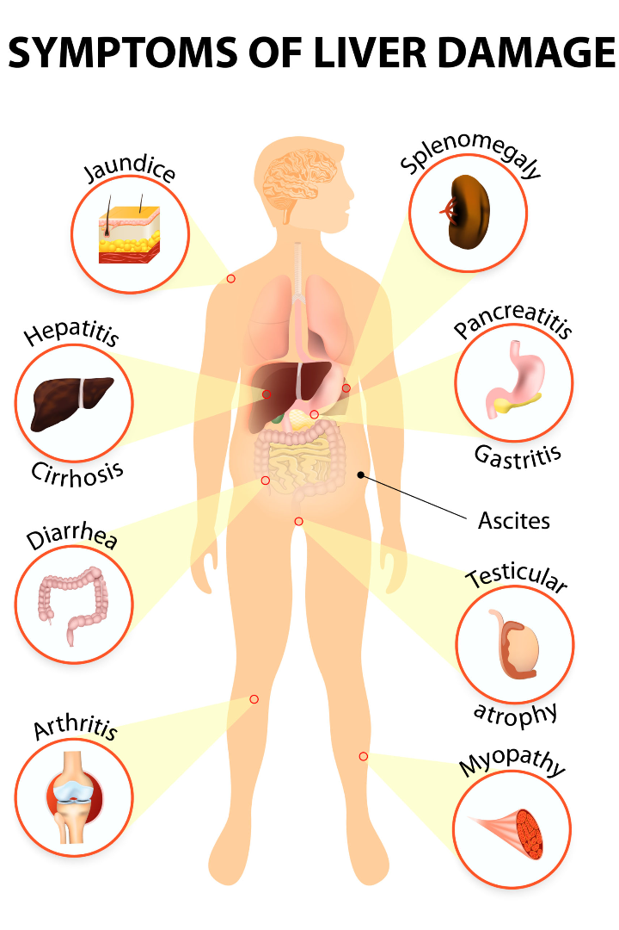
A Review of liver patient analysis using Machine Learning
Liver diseases are life-threatening and require accurate diagnosis. Machine learning, coupled with front-end tools, can help solve this problem. Let's delve into this topic.
Team Members :
K.N.S. S LAKSHMI RESHMA (20NM1A1224)
K. VIJAYA LAKSHMI (20NM1A1225)
K . HARIKA GOWTHAMI (20NM1A1227)
M. V .S. S NAVYATHA (20NM1A1229)

Slide 2
Understanding Liver Diseases
Classifications
Risk Factors
Learn about different liver diseases' types, including hepatitis, cirrhosis, and fatty liver.
Environmental and lifestyle factors play a role in liver diseases. Familiarize yourself with them here.
Symptoms
Early diagnosis of liver diseases is challenging. Explore the signs and symptoms to look out for.

Slide 3
Importance of Machine Learning in Liver Patient Analysis
1
Automated Diagnosis
Machine learning algorithms can quickly analyze medical and clinical data to accurately diagnose liver diseases.
Patient Monitoring
2
Machine learning can monitor patients' progress, predict disease progression and identify adverse outcomes early on.
3
Optimization of Clinical Trials
Machine learning can optimize the design and analysis of clinical trials for liver disease treatments.

Slide 4
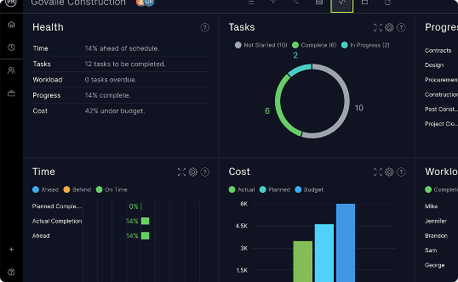


Role of Front-End Technology in Liver Disease Analysis
Data Visualization
Scheduling and Reminders
Mobile Apps
Discover the importance of tools like Javascript-based charts for interactive and visual data representation in liver disease analysis.
Front-end communication tools can help clinicians communicate with patients and follow up on appointments and treatments.
Smartphones and tablets can provide secure and real-time access to patient data, facilitate telemedicine, and improve patient care management.

Slide 5

Challenges in Liver Patient Analysis
1
Availability of High-Quality Data
2
Interpretability of AI Model Results
Liver disease data is often sparse, incomplete, and cluttered, leading to inaccurate predictions and diagnoses.
Machine learning models, while highly accurate, can present challenges in interpreting results and identifying variable relationships.
3
Ensuring Data Confidentiality
4
Regulatory Compliance
Medical data breaches can have devastating consequences for patients and healthcare providers. Ensuring data confidentiality and privacy is paramount.
Healthcare data is highly regulated and requires adherence to complex regulations such as HIPAA, GDPR and others.

Slide 6
Case Studies of Liver Disease Analysis Using ML and Front-End
Case Study 1
Case Study 2
Case Study 3
Creation of a predictive tool with machine learning that can detect early liver disease progression. Front-end technology was essential in providing real-time patient monitoring and data visualization.
Use of deep learning algorithms in identifying and diagnosing liver fibrosis using multiple noninvasive diagnostic modalities. Front-end technology provided an easy-to-use web-based user interface for clinicians to access and analyze results.
Development of a patient monitoring system that predicts liver disease progression using machine learning and front-end technology. The system increases disease monitoring efficiency, resulting in better health outcomes.

Slide 7



Results and Impact of Machine Learning and Front-End in Liver Patient Analysis
Improved Patient Outcomes
Increased Efficiency and Accuracy
Avenues for Further Research
Machine learning and front-end technology have led to timely diagnosis, prevention, and better treatment of liver diseases, saving thousands of lives.
These technologies have opened up new avenues for research and development of tools targeting liver diseases.
Liver patient analysis using machine learning and front-end technology has increased efficiency, clinical accuracy, and improved healthcare resource allocation.

Slide 8

Conclusion and Future Directions
By integrating machine learning and front-end tools in liver patient analysis, we have taken a crucial step in revolutionizing healthcare. However, more research and technological advancements are necessary to continue improving the accuracy, efficiency and effectiveness of liver disease analysis.

